Slide 1
Computer Modeling and Simulation
By
Sara Rehmat
MS(CS)

Slide 2


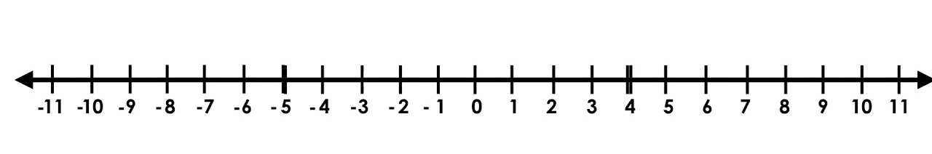
Random Walk along an Integer Line (1D Random Walk)
+1
-1
P(+1) = 1/2
P(-1) = 1/2

Slide 3
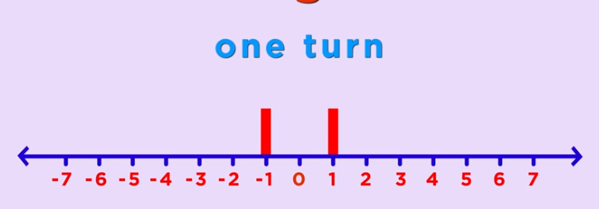
Random Walk along an Integer Line (1D Random Walk)
P(-1)=1/2
P(1)=1/2

Slide 4
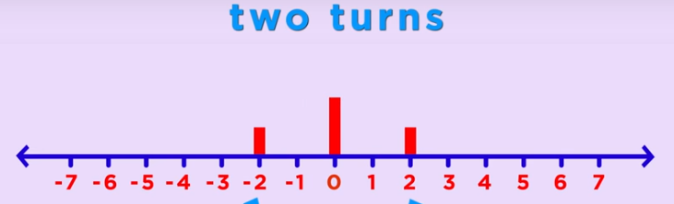
Random Walk along an Integer Line (1D Random Walk)
P(-2)=1/4
P(2)=1/4
P(0)=1/2

Slide 5
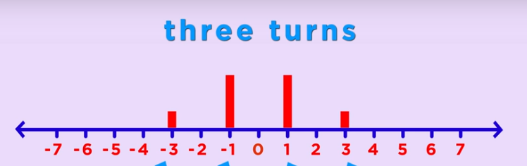
Random Walk along an Integer Line (1D Random Walk)

Slide 6
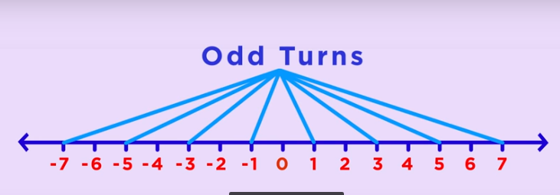
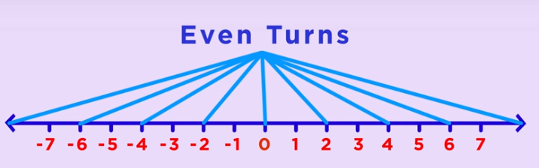
Random Walk along an Integer Line (1D Random Walk)

Slide 7
Probability at different points of integer line in successive coin flips
 | -8 | -7 | -6 | -5 | -4 | -3 | -2 | -1 | 0 | 1 | 2 | 3 | 4 | 5 | 6 | 7 | 8
1st |  |  |  |  |  |  |  | 1/2 |  | 1/2
2nd |  |  |  |  |  |  | 1/4 |  | 1/2 |  | 1/4
3rd |  |  |  |  |  | 1/8 |  | 3/8 |  | 3/8 |  | 1/8
4th |  |  |  |  | 1/16 |  | 1/4 |  | 3/8 |  | 1/4 |  | 1/16
5th |  |  |  | 1/32 |  | 5/32 |  | 5/16 |  | 5/16 |  | 5/32 |  | 1/32
6th |  |  | 1/64 |  | 3/32 |  | 15/64 |  | 5/16 |  | 15/64 |  | 3/32 |  | 1/64
7th |  | 1/128 |  | 7/128 |  | 21/128 |  | 35/128 |  | 35/128 |  | 21/128 |  | 7/128 |  | 1/128
8th | 1/256 |  | 4/128 |  | 7/44 |  | 7/32 |  | 35/128 |  | 7/32 |  | 7/44 |  | 4/128 |  | 1/256
9th

Slide 8
Analysis of the 1D Random Walk
For N coin flips, we’ll most probably be between √N and - √N.
Remember the sailors story?
Let F_{i} denote the outcome of the i^{th} coin flip.
F_{i} is a random variable with equal probability assigned to its two different values +1 and -1.
Let S_{n} denote the location on the integer line after N flips. It’s also a random variable.
S_{n} = F₁+F₂+F₃+….+F

Slide 9
Analysis of the 1D Random Walk
The expected value of F_{i} is (1/2)(+1)+(1/2)(-1)=0
The expected value of S_{n} is the sum of all the expected values of F_{i} i.e. 0.
Over many Random walks, the average of your location will be 0.

Slide 10
Random Walk in 2D
The same holds true for Random Walk in 2D. The entity returns to its starting location multiple times during the walk.
This answers George Polya’s question of “What are the chances of two randomly walking couple bumping into each other?”.

Slide 11
Types of Random Walk
Recurrent walk is the random walk where there is 100% probability of returning to the starting point.
Random walk in 1D and 2D are recurrent random walks.
Transient Random Walk is the random walk in which there is a positive probability that it never returns to its starting .
Random walk in 3D or higher dimensions is transient random walk.
A drunk man will finally find his way back to his home but a drunk bird will be lost forever.

Slide 12
Simple (and not so Simple) Random Walk
What we have seen in 1D Random walk along the integer line is a Simple Random Walk because in Simple Random Walk, we have equal probabilities of moving in each direction.
These probabilities can be different but then it won’t be a simple random walk.
Suppose the probability of moving towards right is p = 3/4, then the probability of moving towards the left is 1 - p = 1/4

Slide 13
Random Walks with different Probabilities
Let p be the probability of moving towards right then the probability of moving towards left will be 1-p,
The expected value of F_{i} is then (p)(+1)+(1-p)(-1) = 2p - 1
The expected value of S_{n} is nFi = n(2p-1)
So your average location after many random walks with the given probabilities will be n(2p-1).
Suppose p=3/4.
For n= 10, S_{n}= 5
For n=100, S_{n}=50

